Slide 1
COMP 3617
Week 7

Slide 2
Data Storage in Android
There are four standard ways to store data locally
Shared Preferences
Preferences API
Internal Storage
External Storage
SQLite Databases

Slide 3
Shared Preferences
Manage application settings as key/value pairs
Provide methods for storing and reading application settings
Interface android.content.SharedPreferences defines these methods
SharedPreferences has getXXX methods that return the value associated with a key
Similarly it has putXXX methods that write value associated with a key

Slide 4
Shared Preferences
SharedPreferences settings are persisted automatically and survive user sessions
Data is deleted when the application is uninstalled

Slide 5
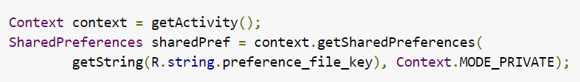
Accessing Shared Preferences
Two ways to access Shared Preferences
With a specific name for the preference file
Common shared preference file per activity

Slide 6
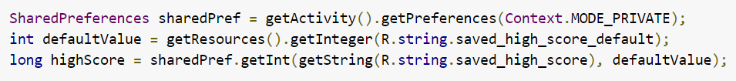
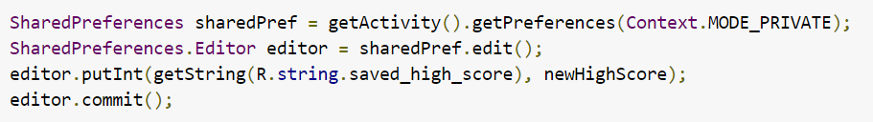
Reading/Writing Shared Preferences
Reading Shared Preferences
Writing Shared Preferences

Slide 7
Preference API
User interface for the settings is optional
Manage both data and user interface
To provide UI for the settings, Android recommends using Preference API
User Interface is limited to text values, checkboxes, dropdown menu etc
Data – collection of name value pairs, where the values are simple types – strings, ints, booleans

Slide 8
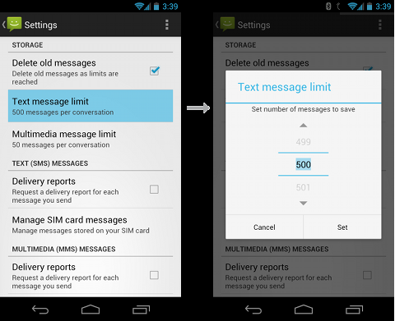
Preference API

Slide 9
Preference API
Each setting in the app is specified by a subclass of Preference class
Each subclass has a set of core properties that you need to specify (eg: title, default value)
Each subclass provides its own specialized properties and user interface
Common Preferences are
CheckBoxPreference
EditTextPreference
ListPreference

Slide 10
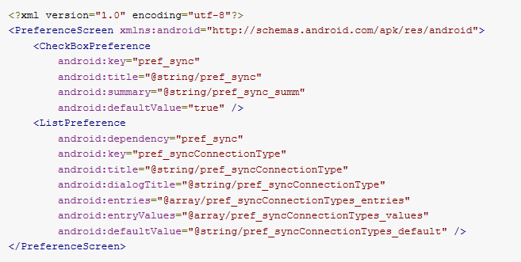
Preference Screen Definition
App Settings are defined using an XML file
Here is an example of one such a file

Slide 11
Preference Attributes
android:key – Unique key (string) the system uses when saving this settings value in SharedPreferences
android:title – Name for the setting
android:defaultValue – Initial value that the system should set in the SharedPreferences
android:summary – Summary for the preference

Slide 12
Displaying Settings
App settings are not built using layout elements but instead using Preference objects
Special Activity/Fragment are required to render the XML definition of Preferences
For Android versions older than 3.0 use PreferenceActivity
For Android 3.0 and above use PreferenceFragment

Slide 13
Reading Preferences
The Preferences are saved to a file in the application directory
The settings (contents of the file) are accessed through PreferenceManager class

Slide 14
Exploring the Android FileSystem
Demo of the File explorer via DDMS
Demo via adb shell

Slide 15
Filesystem Partitions
Three main partitions
Partition | Location | Purpose
User Data Partition | /data/ | Most important partition for an app developer – more details on next slide
System Partition | /system/ | Location of Android OS Main partitions Contains all preinstalled software Mounted read-only
SD Card Partition | /sdcard/ | Storage for all apps Apps require WRITE_TO_EXTERNAL_STORAGE permission Typically used to store music, photos, videos etc

Slide 16
User Data Partition (/data/)
All downloaded and pre-installed apps are located here (/data/app)
Stores all user data (/data/data)
App specific data is stored in /data/data where each app has its own specific folder identified by the package name (eg: /data/data/com.comp3617.assignment1)
Each app can only read the contents specific to it and cannot read other app’s data – this is provided by the security model of Linux where each app is a separate account

Slide 17
Internal Storage
Allows for saving files directly on the device’s internal storage
Private to your application
Uninstalling the app removes these files
To write to a file use openFileOutput call on the activity
To read from a file use the openFileInput call on the activity
Both the methods returns streams based reference
Remember to call close() once you are done

Slide 18
Internal Storage
Here are few useful methods on the activity class related to internal storage
Method Name | Description
getFilesDir() | Gets the absolute path to the file system directory where the internal files are saved
getDir() | Creates or opens an existing directory within the internal storage space
deleteFile() | Deletes a file saved on the internal storage
fileList() | Returns an array of files currently saved by the application

Slide 19
External Storage
Removable storage media (such as an SD card)
Files saved to the external storage are world-readable
Can become unavailable when the user mounts the external storage on a computer or removes the media
Always check the state of the External storage before accessing it
Method getExternalFilesDir() is used to open the external storage directory

Slide 20
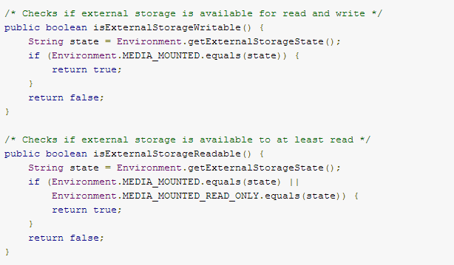
Checking Media Availability
Makes use of a class called Environment

Slide 21
SQLite
Self-contained, server-less, transactional SQL DB engine
Embedded database
Single-file database – security provided by the underlying file system
Open Source project
Runs within the process of your app
Android comes bundled with SQLite
An App can create a private DB and use it from any activity

Slide 22
Main SQLite Classes
Package: android.database.sqlite
Class Name | Description
SQLiteDatabase | Represents a DB
SQLiteOpenHandler | Helper class to manage the DB connectivity
SQLiteQuery | Represents a DB query
SQLiteStatement | Represents a SQL statement
SQLiteCursor | Represents the results from a query
SQLiteQueryBuilder | Builder class for building queries
SQLiteException | Base class for SQLite exceptions

Slide 23
DBHelper
Android apps require special considerations when using DB
Required to create the schema and manage it
To create and access a SQLite DB a subclass of SQLiteOpenHelper needs to be created in the app
Helper class is the conduit to get a connection to the database
Actual SQLite DB is obtained by invoking a call on the getWritableDatabase() or getReadableDatabase()

Slide 24
DBHelper
Provides access to CRUD capabilities
Provides methods to insert, query, update and delete
Some of the method make use of ContentValues container class where you place information to be inserted/updated

Slide 25
SQLite Cursor
Executing queries on the database return a cursor
Cursor points to all the rows found by the query
You navigate the results by looping through the cursor
If you are familiar with JDBC, it is equivalent to the ResultSet class
If you are familiar with ADO.NET, it equivalent to the DataReader class

Slide 26

Debugging SQLite DB
You can use sqlite command line tools to access the DB
Open up a shell via adb
Locate your DB file (usually under /data/data/your-app/databases)
Type sqlite3 and pass in your DB file

Slide 27
Debugging SQLite
Here are some sample commands
.tables – Lists all the tables in your database
SELECT * FROM table_name
SELECT * FROM table_name WHERE colName = ‘value’

Slide 28
SQLiteOpenHelper Wrappers
Provide an abstraction on SQLOpenHelper
Takes away a few pain points dealing with SQLite
Here are a few open source projects that act as wrappers
SQLBrite
StorIO

Slide 29
ORM Projects for Android
SQLite API may seem primitive especially for those coming from Enterprise Application development
SQLite API seems even more archaic than JDBC
Modern frameworks like Java EE and .NET provide higher level abstractions like JPA and Entity Framework
Android does not provide such a framework but there are a few good open source implementations of an ORM framework

Slide 30
ORM Projects for Android
Some popular ones for Android are
ORMLite
SugarORM
ActiveAndroid
greenDAO
DBFlow
Obviously these frameworks add overhead in terms of performance but enable developer productivity
You are welcome to explore them and use them for your final project

Slide 31
Alternatives to SQLite
Couchbase Lite
Realm

Slide 32
Cloud Storage
Most Android apps have a need to store information on the server
You could build your own infrastructure to do so
It has become common to subscribe to those capabilities exposed as a Cloud service from different vendors
More commonly it is called BaaS or mBaaS (Mobile Backend As A Service)
Common providers for these services include Parse, Firebase , StackMob (shutdown now), Kii, Microsoft Azure, Amazon Mobile Services etc

Slide 33
mBaaS
These vendors provide a slew of backend functionality – push notifications, social network integration, cloud storage, analytics etc
MBaaS providers usually provide SDK and APIs for app development
You can pick and chose what capabilities you want to leverage
Most of them offer a freemium model

Slide 34
Parse – mBaaS Provider
We will very briefly look at Parse as a mBaaS Provider
Encourage you to go to http://www.parse.com and register
No credit card is required to sign up
Encourage you to leverage Parse or any other mBaaS provider’s capabilities for your final Project

Slide 35
Firebase
Check out Firebase as an alternate mBaaS provider

